Slide 1
TRUSTEE WORKSHOP
Notes:
WELCOME TO THE TRUSTEE WORKSHOP

Slide 2
TOPICS COVERED
Trustees
Duties of Trustees
Audit Timeline
Prepare for the Audit
Perform the Audit
Complete the Audit
Notes:
TOPICS WE WILL COVER TODAY ARE…..

Slide 3
AUDIT TEAM
Trustee #1
Trustee #2
Trustee #3
Secretary
Treasurer
President
Notes:
All Audits are to be completed by the elected Trustees
With a minimum of two (2) in attendance. At least one (1) must be an elected Trustee.
The President, Secretary, and Treasurer should attend the audit. They are not allowed to perform the audit.
A pro tem can be appointed to audit the books under extenuating circumstances.
The Auxiliary Officers must make every effort to conduct the audit at time and place that allows all the appropriate Officers to attend. Having an audit on a Monday morning when two of the Trustees work, does not allow them to do their duty as Trustees.

Slide 4
TRUSTEES
Bylaws - Sections 802 & 804
3 elected Trustees
Term of Office
Number elected annually
Each Auxiliary and District will have:
A First Year Trustee
A Second Year Trustee
A Third Year Trustee
Notes:
Per Sections 802 & 804 of the National Bylaws: click
Each Auxiliary shall have 3 elected Trustees click
When elected as a 3-year Trustee you shall serve a term of 3 years click
One Trustee will be elected at the time Officers are elected each year. Trustees DO NOT automatically move up if another Trustee resigns. The Auxiliary will elect a Trustee to fill the vacant spot. click
Each Auxiliary and District will have: click
A First Year Trustee. (also known as Senior Trustee) will serve as the Chairman of the Trustees. click
A Second Year Trustee click
A Third Year Trustee click

Slide 5
AUDIT TIMELINE
1st Quarter
2nd Quarter
3rd Quarter
4th Quarter
Jan-Feb-Mar
Apr-May-Jun
Jul-Aug-Sep
Oct-Nov-Dec
Completed by: April 30
To Department Treasurer by:
May 31
Completed by:
July 31
To Department Treasurer by: August 31
Completed by:
October 31
To Department Treasurer by:
November 30
Completed by: January 31
To Department Treasurer by: February 28
Notes:
Trustees need to know what an audit entails and then they can decide how to complete the task. The end result of a proper complete audit is the goal and the Trustees can find the method that works for them. Audits are to be completed no later than the end of the month following the expiration of each quarterly period.
1st qtr audit is for Jan-Feb-Mar and needs to be completed by April 30th and sent to the Department Treasurer by May 31st
2nd qtr audit is for Apr-May-Jun needs to be completed by July 31 and sent to the Department Treasurer by August 31st
3rd qtr audit is for Jul-Aug-Sep and needs to be completed by October 31st and sent to the Department Treasurer by November 30th
4th qtr audit is for Oct-Nov-Dec and needs to be completed by January 31st and sent to the Department Treasurer by February 28^{th .}
If the audit cannot be completed within the first month following the close of the qtr, a valid reason must be given before an extension will be granted by the Department President or Department Treasurer. Failure to get an extension could make your auxiliary no longer eligible for Circle of Champions
CLARIFICATION REGARDING DISTRICT AUDITS
So how are District Audits completed – If you refer to Article 5, Section 511 – District Arrearages – it states that a District Audit must be received within (30) calendar days following your District meeting. The Audit can be conducted on the day of your District Meeting and voted on during that meeting – a special meeting DOES NOT need to be held to conduct the audit. This information came directly from the National Secretary/Treasurer.

Slide 6
DUTIES OF A TRUSTEE
Bylaws - Section 814
Audit books and records
Verify all expenditures
Audit all records & accounts
Sign and date
Complete and read written report for acceptance
Forward signed and accepted audit
Notes:
Duties of Trustees (Sec 814 Bylaws) click
Properly audit the books and records of the VFW Auxiliary Treasurer and Secretary click
Assign tasks to each Trustee, e.g., 1st review Secretary books to ensure disbursements not otherwise supported per Standing Rules, were approved in meeting. 2nd review membership dues and transmittals and 3rd compare deposits and bank statement against treasurer report, etc. click
Verify all expenditures of the VFW Auxiliary and certify by their signatures to the correctness of each bill before payment may be made click
Shall audit the records and accounts of all committees, Officers and members having to do with the receipt and expenditure of the VFW Auxiliary funds and perform such other duties incident to their office as the VFW Auxiliary may direct or the law require such as:
990‐N ePostcard filing, 8822‐B filing, other tax forms click
Sign and date all pages attached to record books at the time of the audit click
Complete the audit and read the written audit report at an auxiliary meeting for acceptance click
Forward a signed accepted copy of the audit to the Department Treasurer no later than the end of the month following the expiration of each quarterly period. If your meeting is before you do the audit you will need to get an extension until the next meeting so that the audit can be read to and accepted by the membership. The Department President is the only person who can grant an audit extension. click

Slide 7
DUTIES OF A TRUSTEE
continued
Bylaws - Sections 814
President & Treasurer bonded
Resignation of a Trustee
Negligence of Trustees
Being in arrears
Notes:
Bylaws – Section 814 continued click
See that the offices of President and Treasurer are bonded with an indemnity company authorized by National HQ or the Department
The bond must be in a sum at least double the amount of funds and value of property for which, so far as can be anticipated, the President and Treasurer may be accountable. The amount of the bond shall be approved by the body and bond premium paid from their funds
The office of President shall hold the original bond of both offices and a copy of the bond shall be incorporated into the minutes each year. click
Should a Trustee resign, move away, etc. the VFW Auxiliary will elect a member to fill the un‐expired term of that particular Trustee. click
Negligence on the part of the Trustees in carrying out the mandates of Section 814 of the Bylaws, or in attending audits, shall make them individually and collectively responsible, with any others, for any discrepancy click
Sec 309 of Bylaws ‐ Any VFW Auxiliary in arrears for failure to bond or to make quarterly audits will be deprived of VFW Auxiliary representation on all levels click

Slide 8
PREPARE FOR THE AUDIT
Items to have available:
Record books
Checkbook
Savings/Investments
Cash receipt book
Receipts and bills
Membership records
Treasurer’s reports
Meeting minutes
Bank statements
Previous audit
Standing rules
Notes:
What items should the Trustees have available? click
Permanent record books of the Treasurer and Secretary. This would include the Treasurer’s ledger and the Secretary’s minutes book. click
The checkbook which includes check stubs or check register
Any savings books or investments and the corresponding statement of accounts. click
Cash receipts book click
Receipts and bills since the last audit click
Membership records such as Transmittals, MemStats Listing Report, Monthly Membership Update Report, Monthly click Membership Transfers Report, and Monthly Membership Paid click
All Treasurer’s reports given at each meeting click
Minutes of each meeting, not just the minutes for the months being audited click
Bank Statements along with canceled checks click
Copy of the most recent audit
Ending balances of previous audit are beginning balances of current audit click
Copy of Standing Rules (if applicable) click
Blank Audit Forms click

Slide 9
WHAT TO REVIEW
Receipts/Disbursements
Minutes
Standing Rules
Compare the checkbook to the Treasurer’s Report
+
-
=
Receipts
Disbursements
Balances
Notes:
A proper audit means a lot of flipping back and forth between difference books. Trustees must review the receipt book and checkbook and compare both with the treasurer’s report. Then the Trustees must also confirm that all disbursements recorded on the Treasurers report were approved and either reflected in the minutes or is covered under the Auxiliary Standing Rules click

Slide 10
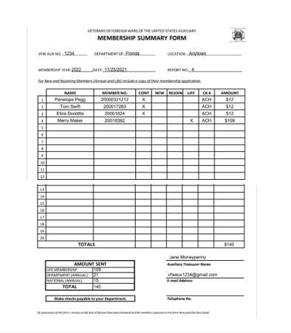
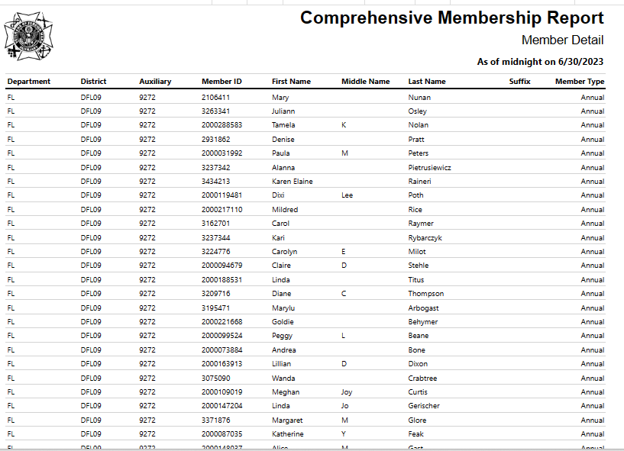
DUES AND MEMBERSHIP
TRANSMITTAL
Notes:
Dues and membership transmittal/summary. We need to check the dues receipts to the dues transmitted. To do this, the Trustees will need to check the receipts against the transmittals to ensure dues received were properly processed and the proper dues disbursements transmitted to the Department Treasurer. click

Slide 11
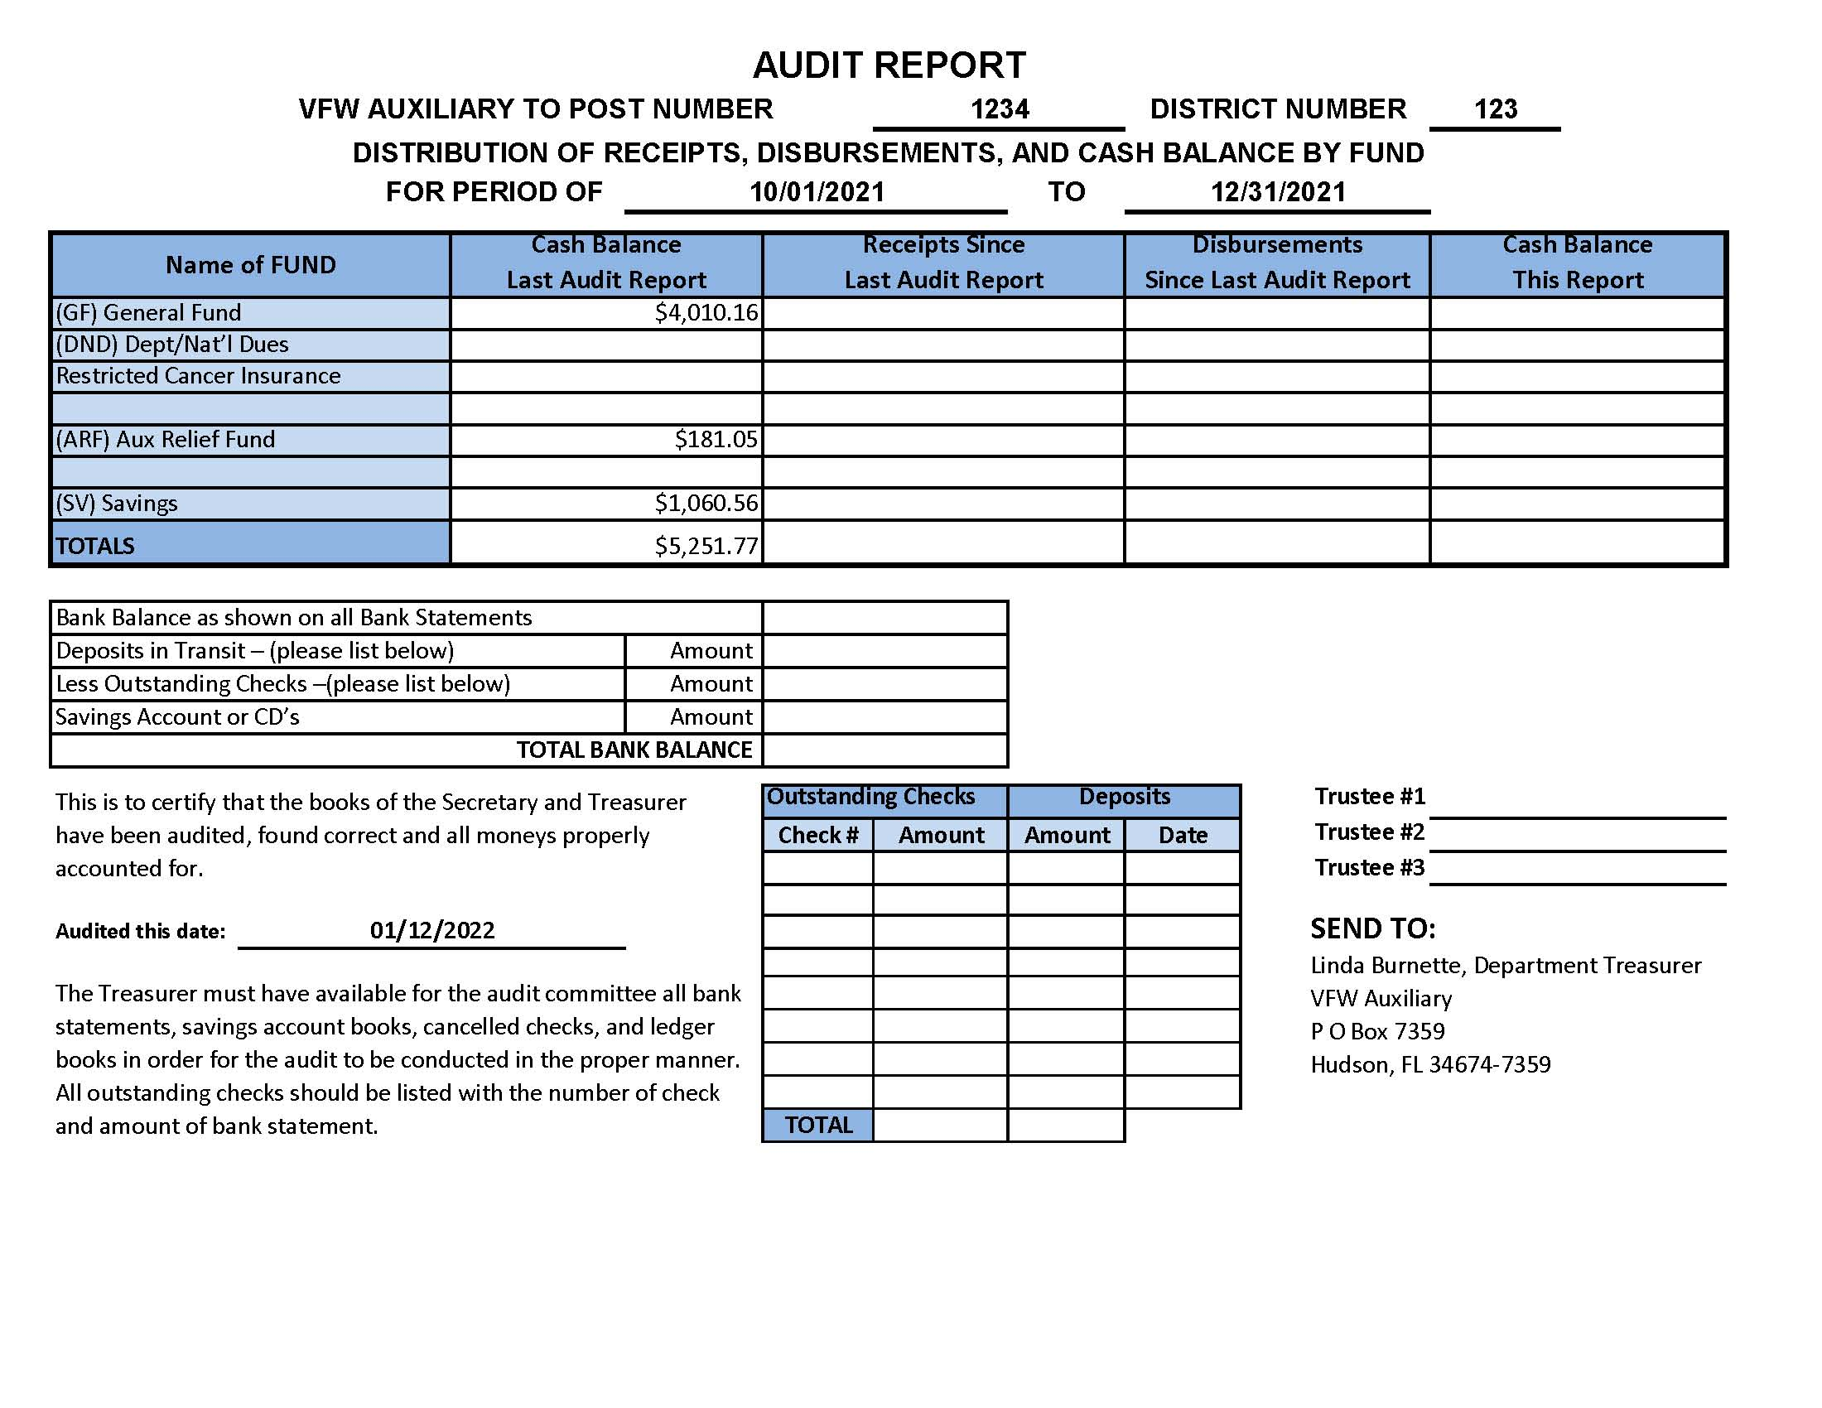
7,674.22
5,634.01
6,050.37
557.00
569.00
-12.00
16.00
0.00
197.05
Totals
$4,191.21
8,247.22
6,203.01
6,235.42
9.72
1,070.28
8,256.94
6,203.01
7,305.70
6,235.44
1,070.28
7,305.70
Notes:
Now that we have seen that everything has matched or been accounted for, the audit form can be filled out. First you need the last audit form to get the Cash Balance last report. Bring the Cash Balance. Next you need to add up all the receipts for the quarter in the appropriate fund. Add all of the disbursements for each fund. Each column should be totaled down. Each line should be added across. Cash Balance last report + receipts since last audit – Disbursements since last audit = cash balance this report. The total balance of all funds should total your bank balance. If you have savings or any other accounts or investments, you need to enter all receipts/disbursements from these accounts so we will add the interest from our savings statements for the last three months. Add them across. Then add the totals down. Lastly, balance the bank statement at the bottom. It is ok for the treasurer to come with an audit report all filled out. This can be used to check the trustees. If there is an error, it narrows down where to look for the error. If the trustees’ report matches the one prepared by the Treasurer, it is ok to sign the treasurer’s copy because that is probably printed with formulas already added. click

Slide 12
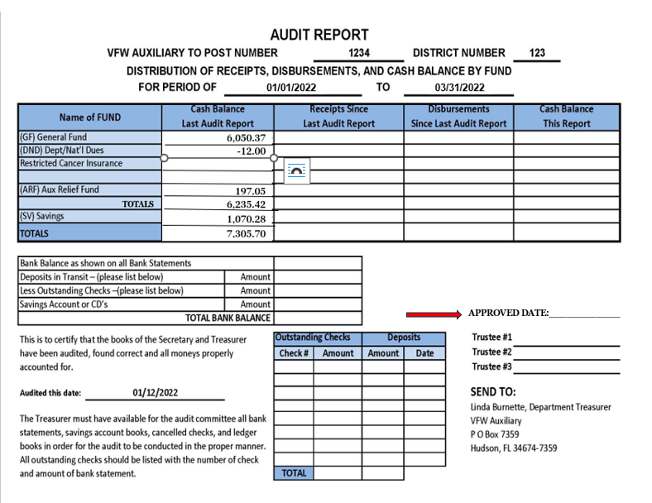
Preparing for the next quarterly audit
Notes:
When preparing the audit report of the next quarter, the ending balances from the last quarter audit must be entered into the new audit report under the CASH Balance from Last Audit Report

Slide 13
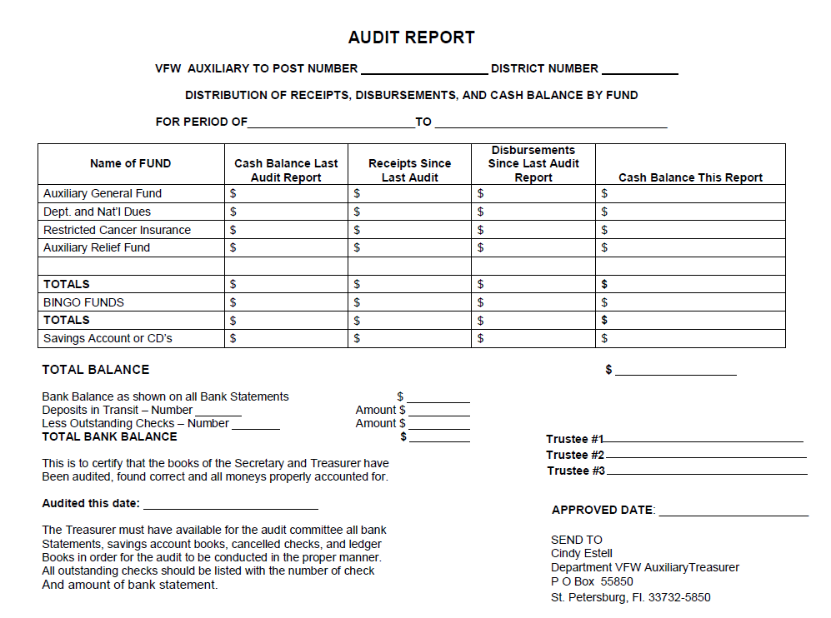
Notes:
We have added an “APPROVED DATE” to the blank audit report posted on the Department website under Resources/Treasurer or President/Secretary links

Slide 14
COMPLETE THE AUDIT
Sign the audit
Sign Treasurer books
Sign Secretary books
Sign checkbook
Audited and Found Correct on 7/22/2024
Trustee 3
Trustee 2
Trustee 1
Sign deposit book
Sign bank statement
Sign savings statement
Notes:
Is that the end of the job? No, click the trustees sign the Audit, click they sign the last page of the treasurer’s book, click the last page of the secretary’s book, click the checkbook where the last check of the period was written, click sign deposit book click the most recent bank statement, click the most recent savings statement if applicable. click The Trustees need to initial all pages of the treasurer’s click and all pages of the secretary’s books (if they are not in a bound book)
The senior trustee is responsible for reading the report at the next meeting. They give a copy to the Secretary and send an approved copy to the Department Treasurer. Now, the job is done. click

Slide 15
ANY QUESTIONS?

