Slide 1
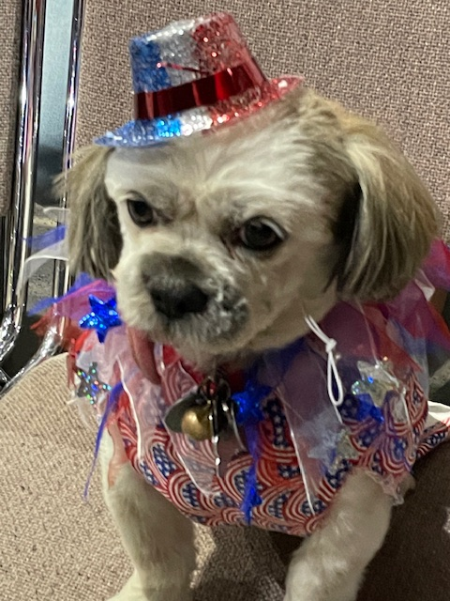
Extension, Revitalization & Mentoring
School of Instruction, Dept. of Florida Aug. 2024
Debbie McCollum, Chief of Staff

Slide 2
Extension & Revitalization
From our Roots to our Branches
Extending Service to our Veterans

Slide 3
Extension & Revitalization
What’s a bachelor/Unaffiliated Post??
Are there Bachelor Posts in your District?
To Start a new Auxiliary,
Minimum requirements
2/3’s vote by Post to have an Auxiliary
Minimum 15 NEW members (transfers join later)
Extension tools and presentations are available in MALTA Member Resources.

Slide 4
Extension & Revitalization
Tools
Maintaining Healthy Auxiliaries Tool Kit
Building on the VFW Auxiliary Foundation
VFW Auxiliary Mentoring Guide

Slide 5
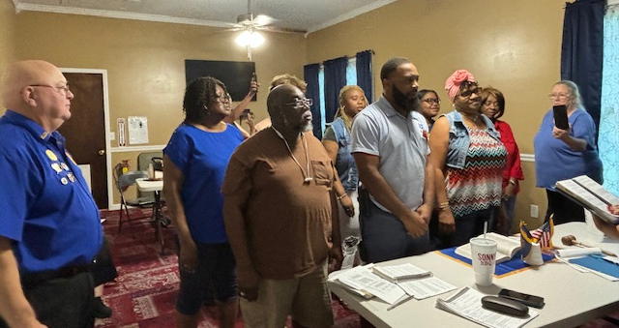
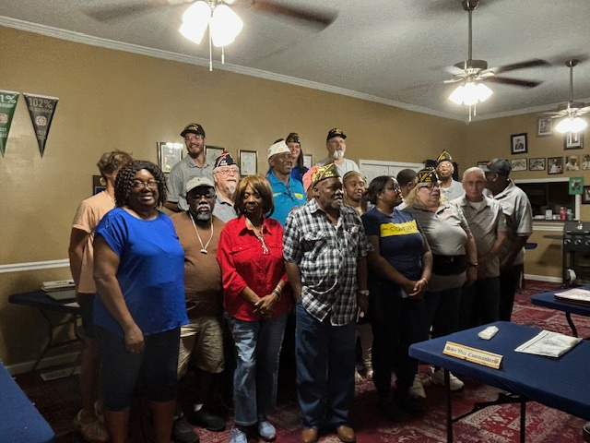
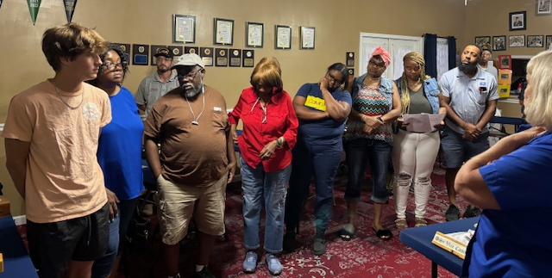
Welcome to our newest Auxiliary- Marianna #12096 Instituted July 11, 2024

Slide 6
Mentoring
Red Light
Not Good, headed toward a possible suspension
Yellow Light
Caution– Stagnant officers, activities limited new members
Green Light
Great, new officers, new active members, enthusiasm
This Photo by Unknown Author is licensed under CC BY-SA

Slide 7
Welcome new members, find their interests & get them involved
C - Catch the member when they first join.
A - Ask them to participate.
R - Remember what it felt like to be new.
E - Engage them in a Program that fits their interests.

Slide 8
Listen to All your members
The most important skill is to Listen to all ideas-
Don’t dismiss the thoughts because you have tried that before!
Listen to understand, not just parrot an answer you think they want to hear.

Slide 9
Leaders & Mentors-
Are you
Approachable
Open and eager to hear new ideas
Are you your Auxiliary’s biggest cheerleader

Slide 10
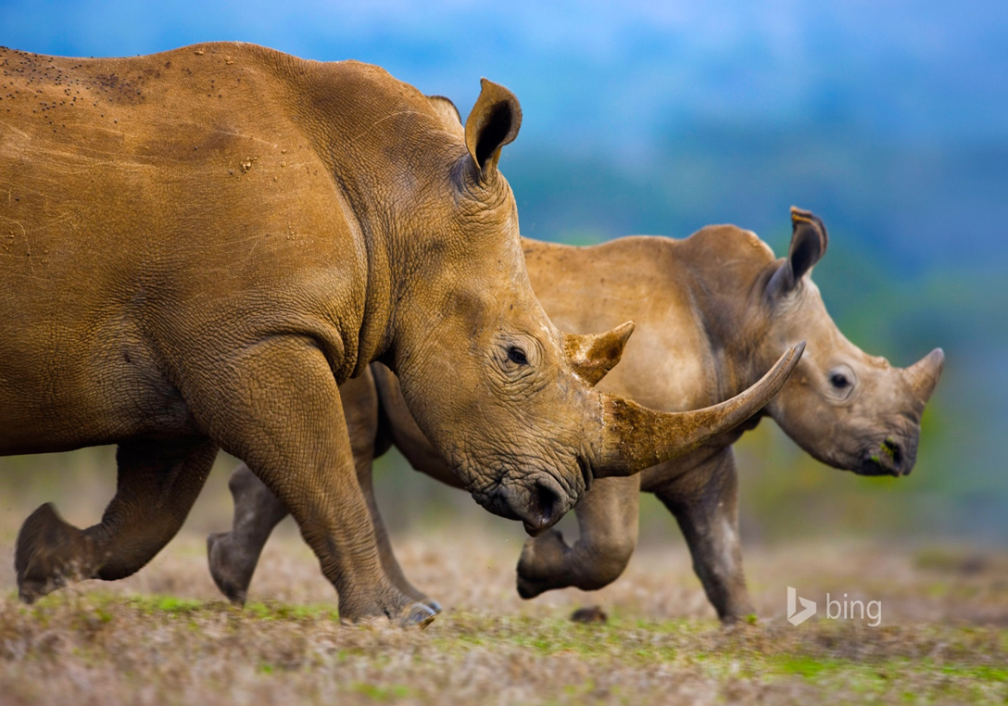
Bullies & Rhinos should not be a part of your Auxiliary
Auxiliary meetings, events and social networking sites should be free of the following:
Intimidation
Humiliation
Hostility
Harassment of any sort: verbal, physical, visual
Other unpleasantness

Slide 11
Thanks to Everyone that has Mentored an Auxiliary Member!
Questions ?

